Slide 1
RFID ATTENDENCE SYSTEM COMPONENTS

Slide 2
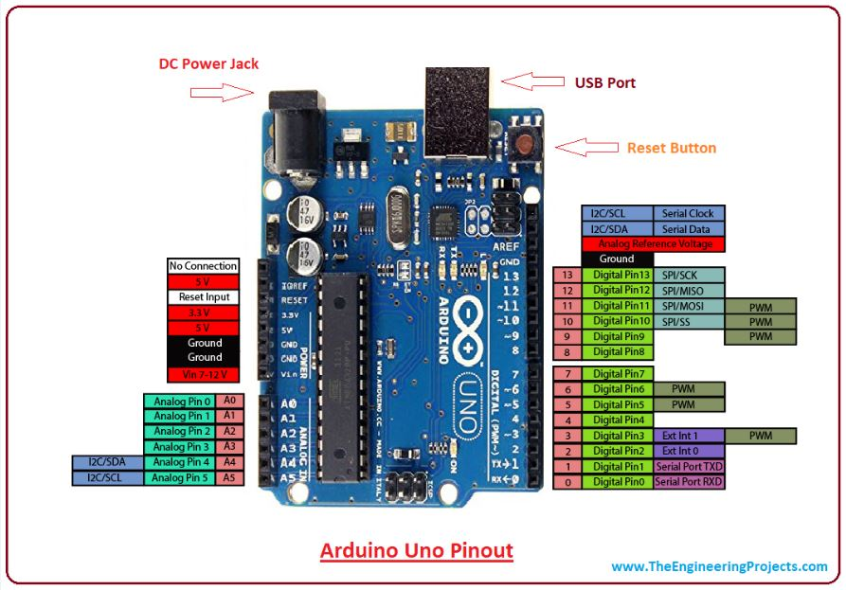

Slide 3
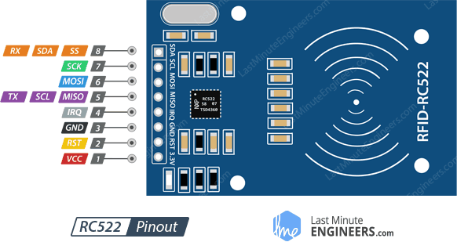

Slide 4
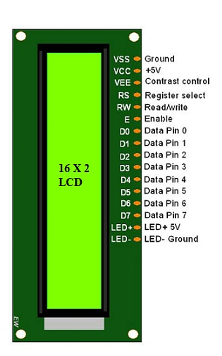

Slide 5
